Slide 1
Java static keyword
The static keyword in java is used for memory management mainly. We can apply java static keyword with variables, methods, blocks and nested class. The static keyword belongs to the class than instance of the class

Slide 2
The static can be: 1.variable (also known as class variable) 2.method (also known as class method) 3.block 4.nested class

Slide 3
1) Java static variable If you declare any variable as static, it is known static variable. *The static variable can be used to refer the common property of all objects (that is not unique for each object) e.g. company name of employees,college name of students etc. *The static variable gets memory only once in class area at the time of class loading. Advantage of static variable It makes your program memory efficient (i.e it saves memory).

Slide 4
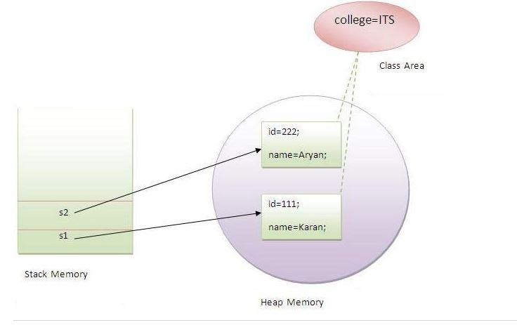

Slide 5
2) Java static method If you apply static keyword with any method, it is known as static method. A static method belongs to the class rather than object of a class. A static method can be invoked without the need for creating an instance of a class. static method can access static data member and can change the value of it.

Slide 6
Q) why java main method is static?
Ans) because object is not required to call static method if it were non-static method, jvm create object first then call main() method that will lead the problem of extra memory allocation.

Slide 7
Q) Can we execute a program without main() method? Ans) Yes, one of the way is static block but in previous version of JDK not in JDK 1.7.

